Slide 1
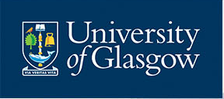
Creating a curriculum centered on reproducible research
Phil McAleer
School of Psychology, University of Glasgow
#PsyTeachR
philip.mcaleer@glasgow.ac.uk @mcaleerp @uofgpsychology

Slide 2
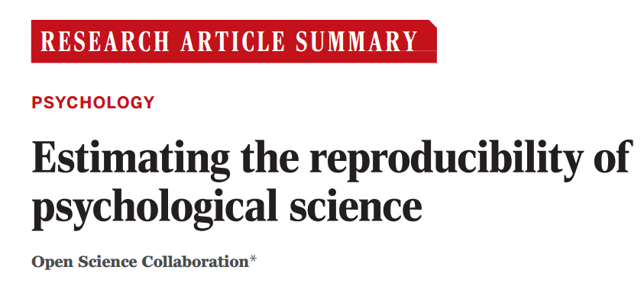
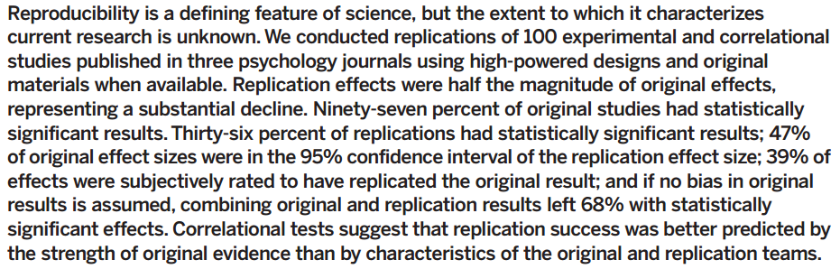
http://science.sciencemag.org/content/349/6251/aac4716.full.pdf+html
100 Published Papers Reviewed
36% replicated original finding
64% found no effect, a weaker effect, or the opposite effect to the original finding.

Slide 3
2016
‘Changing these incentives [for publication of positive results etc] requires a cultural shift in both thinking and practice. Improved doctoral and postdoctoral research methods training is vital (Munafò et al., 2014). However, changing scientific culture can begin at the undergraduate level, instilling the principles of transparency and scientific rigor at the grassroots.’
https://thepsychologist.bps.org.uk/volume-29/march-2016/instilling-scientific-rigour-grassroots

Slide 4
2016
‘carry out an extensive piece of empirical research that requires them individually to demonstrate a range of research skills including planning, considering and resolving ethical issues, analysis and dissemination of findings.’
https://www.qaa.ac.uk/

Slide 5
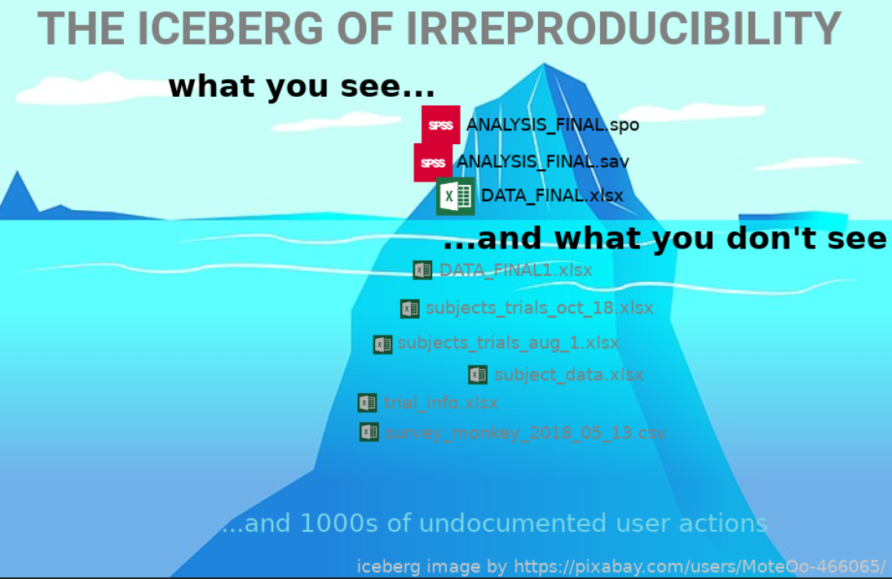
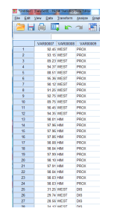
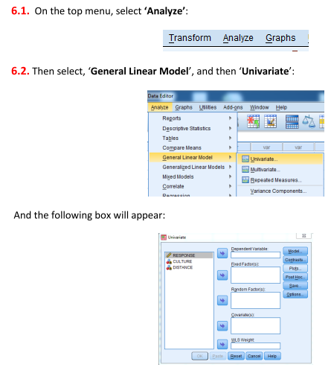
https://talklab.psy.gla.ac.uk/barr_sips_2019/

Slide 6
https://talklab.psy.gla.ac.uk/barr_sips_2019/

Slide 7
Knowledge and Skills Gap
no formal instruction on structuring, transforming, and visualizing data, despite these activities being:
the most time consuming
the most complex and thus error prone
absence of formal instruction leads to
shallow reproducibility of projects at best
over-confidence in some areas as well as insecurity and negative self-image
lack of knowledge of reproducibility and issues in the field
again no strong formal training outside lectures on topics

Slide 8
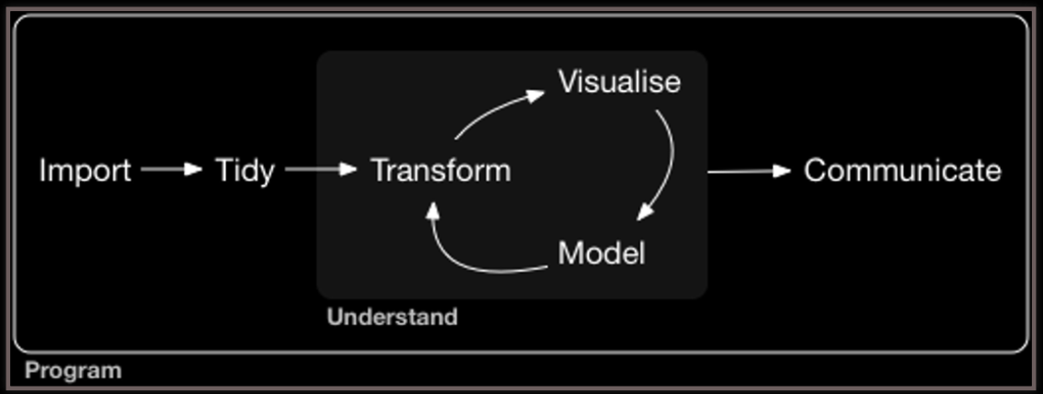
Grolemund & Wickham (2017), R for Data Science
Traditional Focus

Slide 9
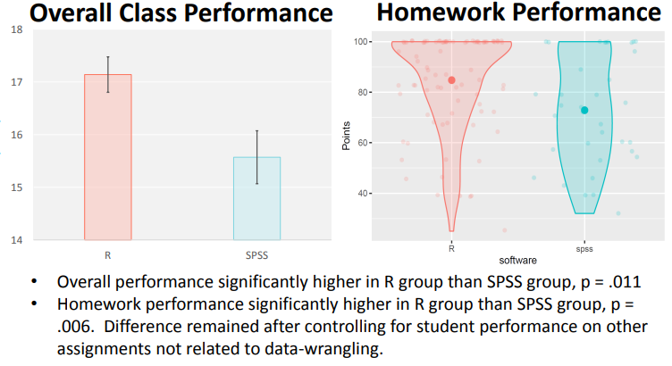
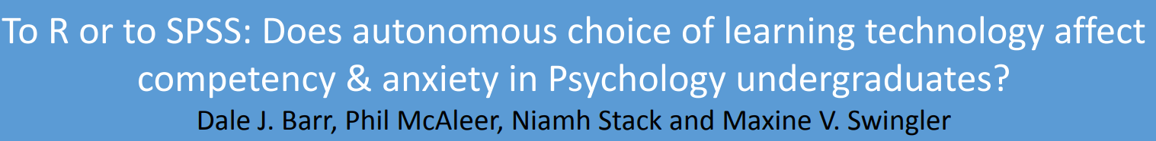
https://psyteachr.github.io/trdair_workshop/LTC_workshop.pdf

Slide 10
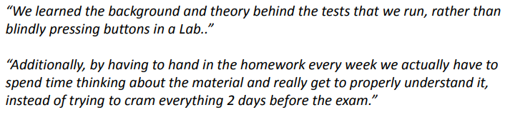
https://psyteachr.github.io/trdair_workshop/LTC_workshop.pdf

Slide 11

https://psyteachr.github.io/
Our curriculum now emphasizes essential ‘data science’ graduate skills that have been overlooked in traditional approaches to teaching, including programming skills, data visualisation, data wrangling and reproducible reports. Students learn about probability and inference through data simulation as well as by working with real datasets.
Working with data and research in a reproducible fashion

Slide 12

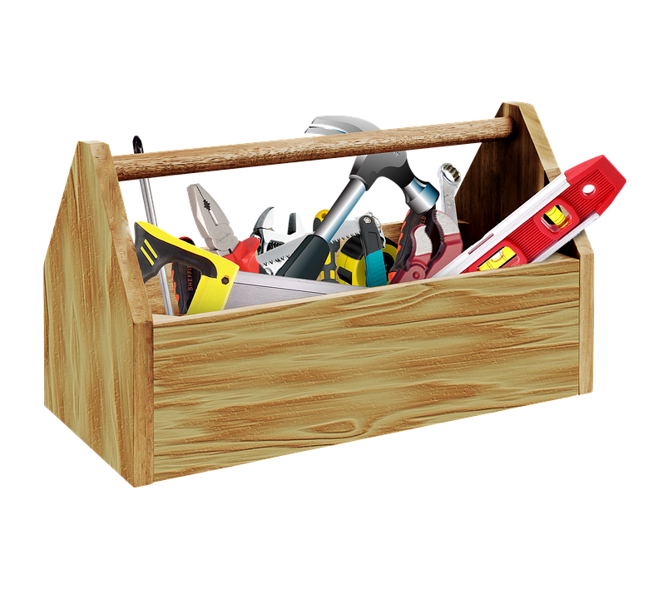
=
R is our tool as it allows us to teach the skills we want our students to have.
You have to be clear on what it is you want students to learn regardless of software.
Added benefit of being free to use allowing for greater student independence.

Slide 13
Novice
Expert
Knowledge + Practice + Feedback =
Skilled
Time
True for any practical skill including data wrangling, analysis, visualisation, placement of citations, report writing and paragraph structure, etc.
Teaching is about breaking down the skills into knowledge and supplying opportunities for practice and feedback
Additional element of flexibility – the skills stay the same; only the data changes
Didau: https://learningspy.co.uk/learning/novice-expert-model-learning/

Slide 14
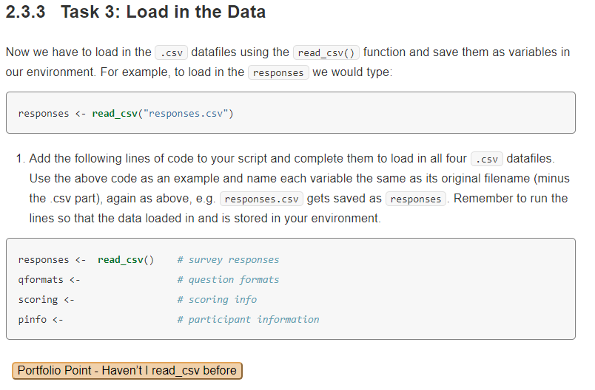

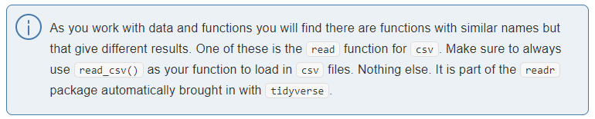
use a novice friendly syntax
real data wherever possible
PreClass, InClass, Assignment
Knowledge, Practice, Feedback
https://psyteachr.github.io/ug2-practical

Slide 15
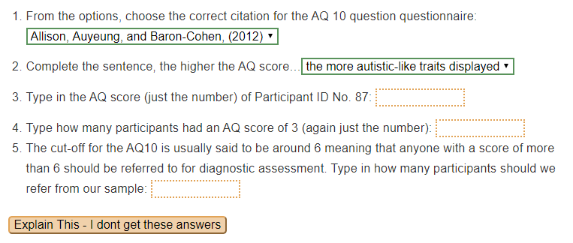
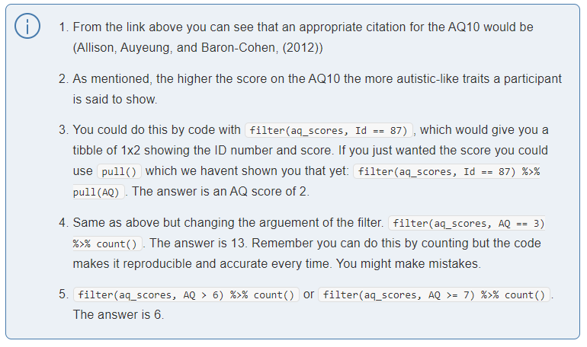
Integrate theory, research methods, terminology as well as data skills
Allow for formative self-assessment using webex package and RMarkdown
https://cran.r-project.org/web/packages/webex
https://psyteachr.github.io/ug2-practical

Slide 16
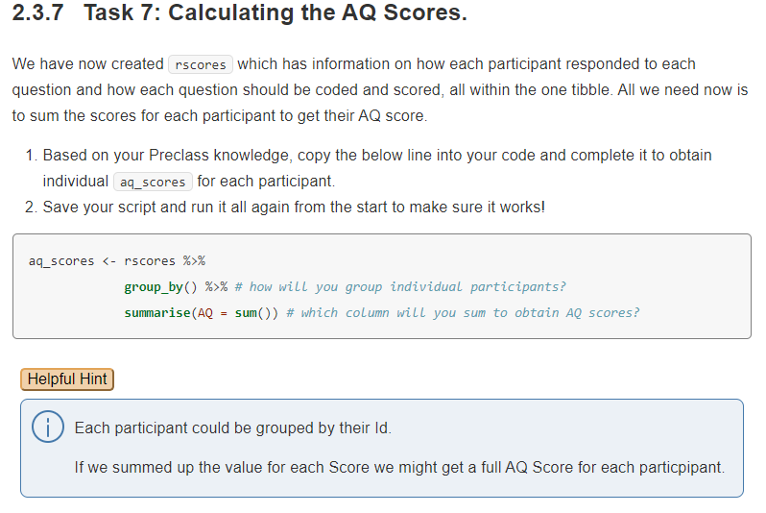
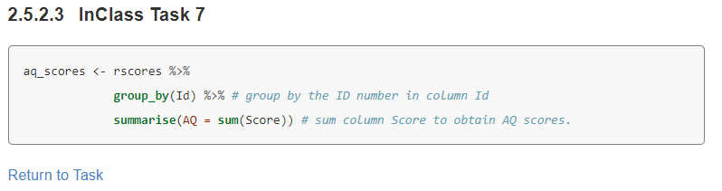
Increase complexity and reduce hints as chapters progress
Solutions are at the end of each chapter to allow people to check themselves and to move on
https://psyteachr.github.io/ug2-practical

Slide 17
Year | Topics | N | College/Additional Subjects
1 | IDE, Coding, data wrangling, visualisation, probability, descriptives | ~500-600 | Psychology + College Specific Modules: Arts: English/History/Languages/etc Social Science: Business/Sociology/etc Science: Biology/Chemistry/Computing
2 | Recap L1 skills, simulate data, power, inferentials (correlations, regressions, t-tests), the GLM | ~300
3 | Simulation based approach to mixed-effects models, psychometric data | ~150-200 | Various modules related to Psychology
4 | Advanced topics such as factor analysis, bootstrapping and permutation tests
Build the skills as you go with focus on becoming confident and competent
Build a solid foundation in key skills (wrangle, visualise) before moving on to analyses
It is ok to slow it down. You do not have to teach everything; teach a few things well

Slide 18
One year course; N = ~200
Diverse graduate skill sets within cohort from degrees in arts to science with varying goals
Very few have data skills or research methods background
About 30 hours to learn methods, stats and communication
10 week course; N = ~ 60
Diverse graduate skill sets from undergrad psych and neuroscience degrees & plan to do a PhD.
Some have data skills, many have research methods and stats knowledge, many don’t have any of this
20 hours of Data skills that prepare students for advanced stats course
Regardless of duration of course what is fundamental is that you teach the knowledge and skills you want your students to gain in your course

Slide 19
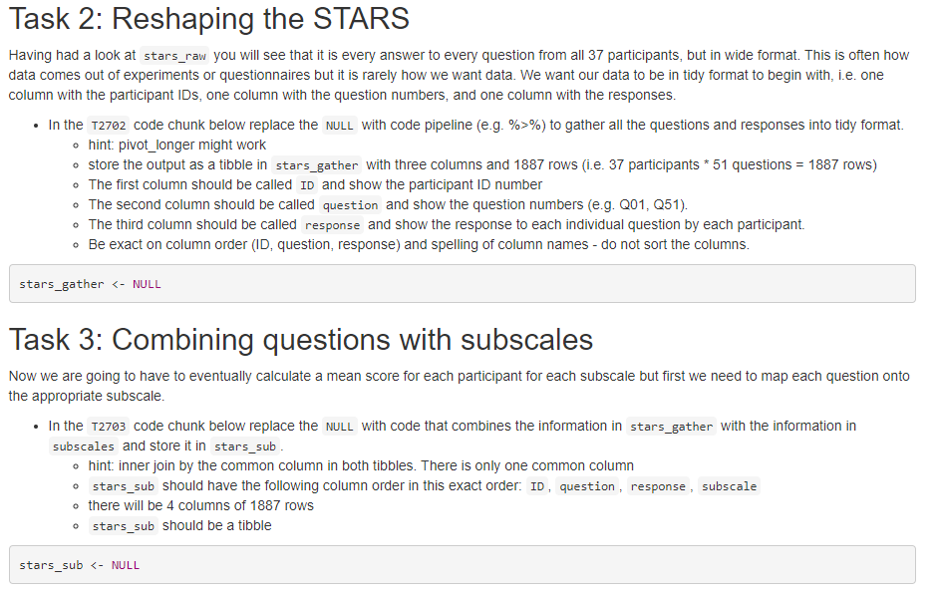
Regular assignments in RMarkdown that tests the knowledge and skills, building complexity week on week, with strong notion of the code must be reproducibile.

Slide 20
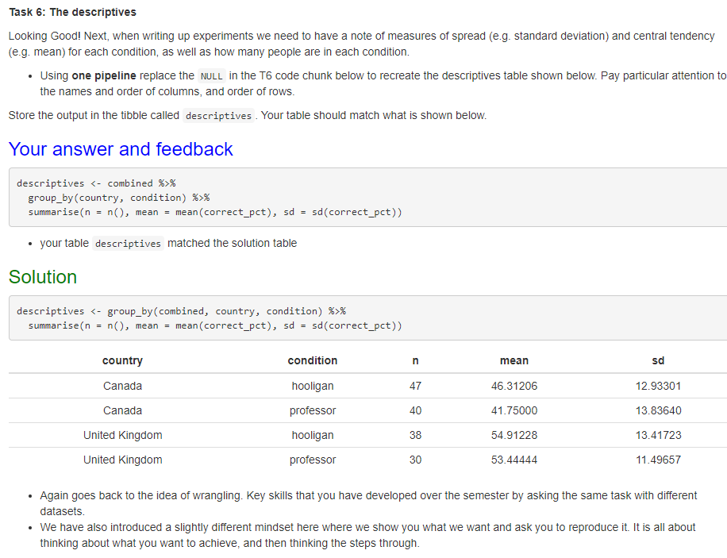
Students get individual as well as generic feedback allowing us to reinforce corrections to common mistakes.
E.g. Not looking at output.
https://github.com/dalejbarr/assessr

Slide 21
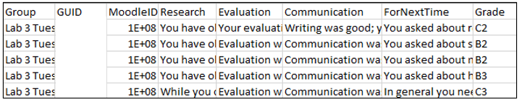
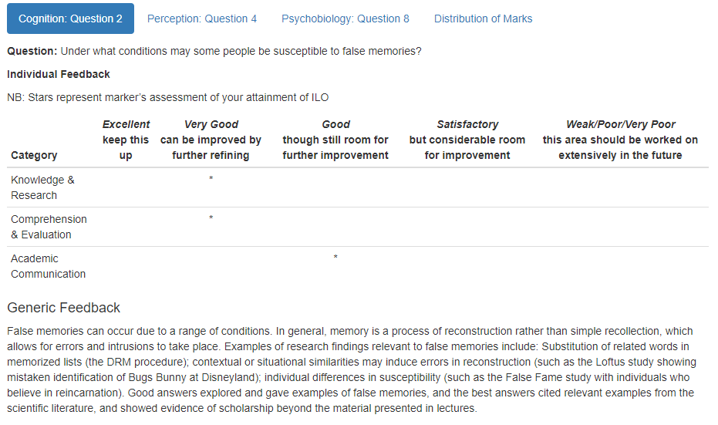
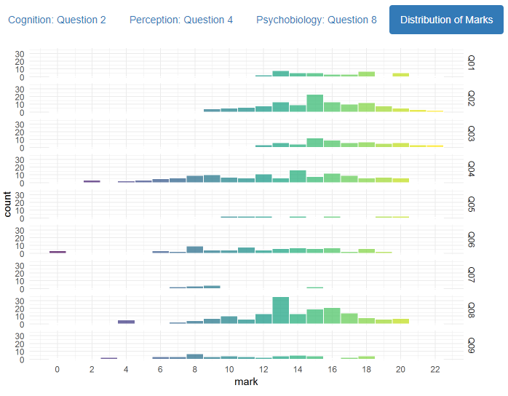
Demanding on staff to learn this approach and novel ideas.
Integrate where possible to improve uptake
Coding skills benefit staff both in terms of own research and admin
markR package
https://debruine.github.io/markr2/

Slide 22
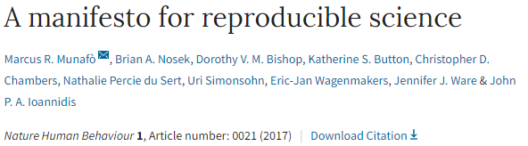
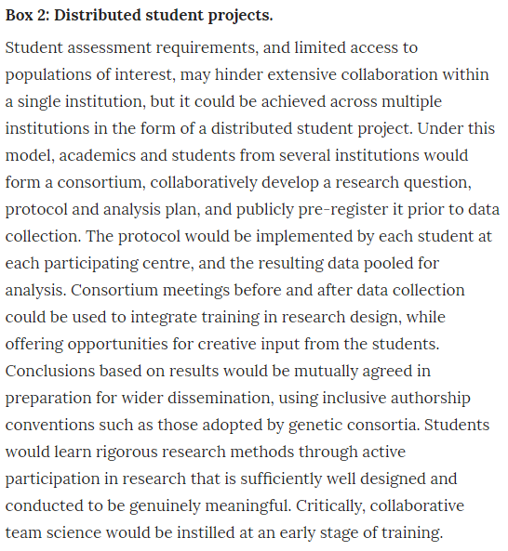
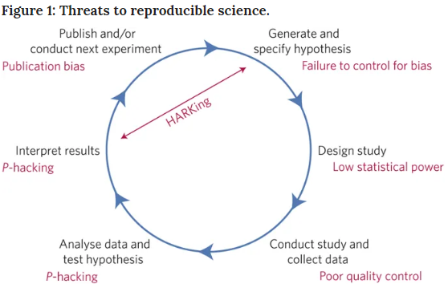
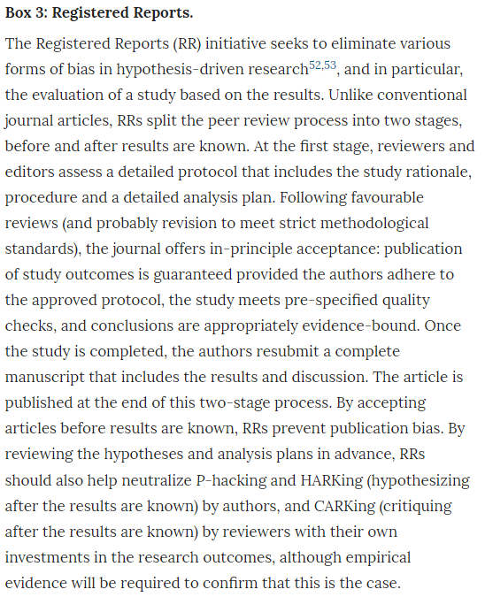
Not just about coding

Slide 23
Not just about coding
Assignments based on reproducible research methods to develop the understanding and knowledge of different practices
Essays:
Help develop understanding of terminology and improve critical thinking in the area
Discuss whether reproducible research is important to Psychology or not?
Evaluate whether a ManyLabs approach is beneficial in developing new theory?
Evaluate how the task may influence findings in personality perception research?
Peer-Review of Preprints
Shows that the published articles are not error free
Develops a healthy skepticism of published research
Develops writing skills, critical thinking on methods, and professional courtesy
Using open access peer-reviews and pre-printed submissions to improve students’ comprehension of academic writing: http://eprints.gla.ac.uk/162868/7/162868.pdf

Slide 24
Not just about coding
Registered Reports
Starter topics to develop just the introduction and methods on new research
Focus on the research question and approach and not the outcome
Develops students understanding of justification, design, and rationale
Encourage forward planning and thinking about reproducibility from the start of a project
Secondary Data Analyses and Pre-Registrations of a known dataset
Real data that real psychologists have gathered (often in our School)
Helps show the worth of the skills we have been developing
Shows data is big and messy, and that the findings in a research article are partly based on the decision a researcher makes in the design and analysis
Teaches about documenting analysis plan and deviations from it

Slide 25
Not just about coding
Added benefit: the conversations & discussions that these assignments spark
E.g. Registered Report
How many participants would you include?
How do you decide that? Power Analysis vs Previous Research
The previous research uses less participants than the Power Analysis suggests yet finds a significant effect. What does that mean?
Leads to discussion of issues of false positives, false negatives, replications, in a context that students understand better because it is in a project they are interested in and are developing themselves. Real issues and real problems to understand and think about approaches to.
Students become more aware of the issues in research and how to do better in future assignments and projects.

Slide 26




Bringing the tools and ideas from our research communities into our teaching to develop the skills we want students to have.

Slide 27
Building a community
You can change as much as you like but a sense of community is vital to making it last.
Group work dominates a lot of our classes with students working with peers as we would work with colleagues in a lab
Support creates trust with people becoming more open to talking about mistakes and errors, and asking for help.
Seminar and Workshop Series based around methods and metascience that is open to both students and staff to present ideas and questions: https://psyteachr.github.io/mms/

Slide 28
Changes don’t have to be complex. Even changing a lab environment from isolated desks to a layout that promotes discussion, as we would have in our own lab meetings, helps create a community.

Slide 29


Student-led channels where both students, and staff, can help out other students.
Staff don’t give answers but refer students back to previous assignments and previous feedback, just like we would if we were stuck
Staff-only channels to help transition
Acknowledge that not all students, or all staff, are from the same mould and different people work at different speeds and need different support
https://slack.com/intl/en-gb/
https://www.microsoft.com/en-gb/microsoft-teams/group-chat-software

Slide 30
HELLO
I AM…
Here to Help
We employ our Postgraduates as Graduate Teaching Assistants in our labs to help both students and staff and to serve as a link between the two
There is no need to be an expert
Read through the code (the tidyverse helps here)
Don’t touch the keyboard
You are not learning R. You are learning skills using R.

Slide 31
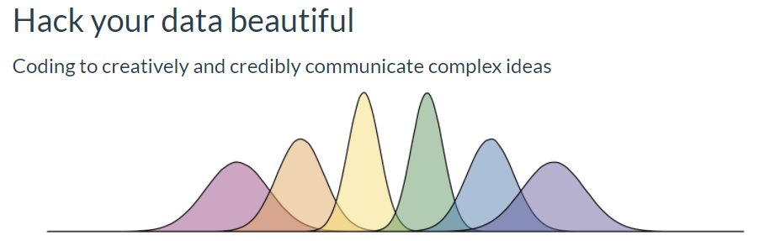
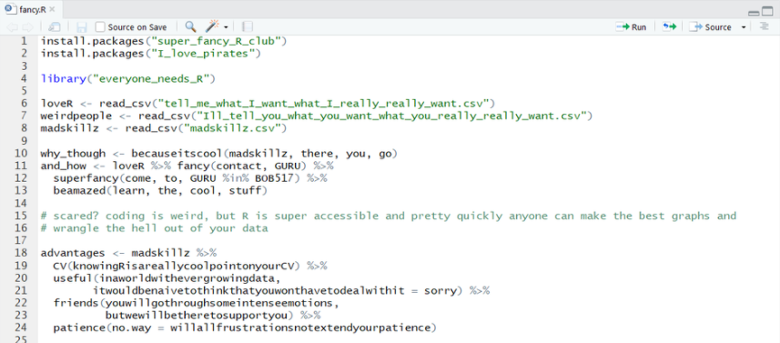

https://psyteachr.github.io/hack-your-data/
@GuruGlasgow

Slide 32
Final Thoughts
Changing a curriculum is challenging to say the least
Know the rationale & explain that clearly to your students
Students want to learn and be challenged, and have chosen your course for a reason - most likely interest in the topic. Make the most of that to teach them good practice in your field.
There is a learning curve for both staff and students so show the benefits to both parties, and never underestimate the importance of community
Increased job opportunities and desirable graduate skillset
Student independence creates staff time and allows for better projects
Not everyone is in the position to make wholesale changes
Find the one small thing you can change that will benefit your students and change that.

Slide 33
Student Perspective
Student 1: Knowing about reproducibility and issues in reproducibility early on in the undergrad has helped me to be more critical about the papers that I read, but also helped me in designing my own studies. You know the pitfalls, issues that prevent reproducibility, so you know the things to look out for.
Student 2: Learning the skills from level one has given us the tools to evaluate research when writing essays. It has allowed us to take more of a critical look at a paper's methods and therefore question its results. An important skill for doing well in coursework….. Although challenging at first, perseverance with the principles and tools of open science and reproducibility will open so many opportunities during your undergraduate and beyond. It's like a muscle group. The more you work at it, the stronger it gets and you'll see the results.

Slide 34
Conclusion
Identify the knowledge and skills you want your students to have
Identify the tools and assignments that allow you to teach those aspects
Integrate into teaching, research, and admin
Everyone benefits from teaching based around reproducible methods as the skillset goes beyond the classroom.
@mcaleerp & @uofgpsychology
philip.mcaleer@glasgow.ac.uk

Slide 35
Community
These changes have truly been a team effort between staff and students and every single one of them should be thanked for helping to improve the teaching of research methods in our School.
Special mention to:
Dale Barr, Lisa DeBruine, Emily Nordmann, Helena Paterson, Niamh Stack, & Heather Cleland Woods. Find them all on twitter as they are all awesome!
@mcaleerp & @uofgpsychology
philip.mcaleer@glasgow.ac.uk

